Slide 1
MUSIC LESSON

Slide 2
What is the most powerful instrument everyone has?

Slide 3
Their voice

Slide 4
Does anyone have a favourite rapper?

Slide 5
My favourite rapper is my grandma.

Slide 6
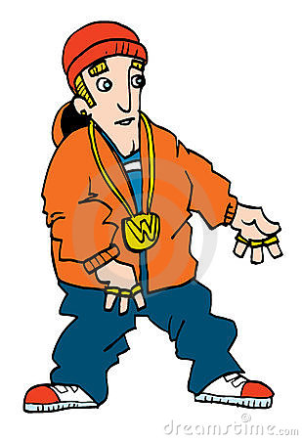
THE GRANDMA RAP

Slide 7
VERSE 1
Grandma, Grandma, sick in bed,
She called for the doctor and the doctor said,
Grandma, Grandma, you ain’t sick;
All you need is a walking stick.

Slide 8
VERSE 2
And an up, shake, shake, shake, shakerdy, shake,
And a down, shake, shake, shake, shakerdy, shake,
And an up, shake, shake, shake, shakerdy, shake,
And a down, shake, shake, shake, shakerdy, shake,

Slide 9
VERSE 3
To the back, to the front, to the s-s-side,
To the back, to the front, to the s-s-side’
She never went to college, she never went to school,
But I bet your bottom dollar she can wriggle like a fool

Slide 10
Now try adding some percussion. Find some objects around your house that you could use as a drum, or something to make a shaking sound. Use your imagination!
You could then try adding a dance to it.
You could teach it to your family members and get them to join in and ask someone to take a video of you. If you do, send it to 5thclassmscleary@gmail.com so that I can see your creation!

