Slide 2
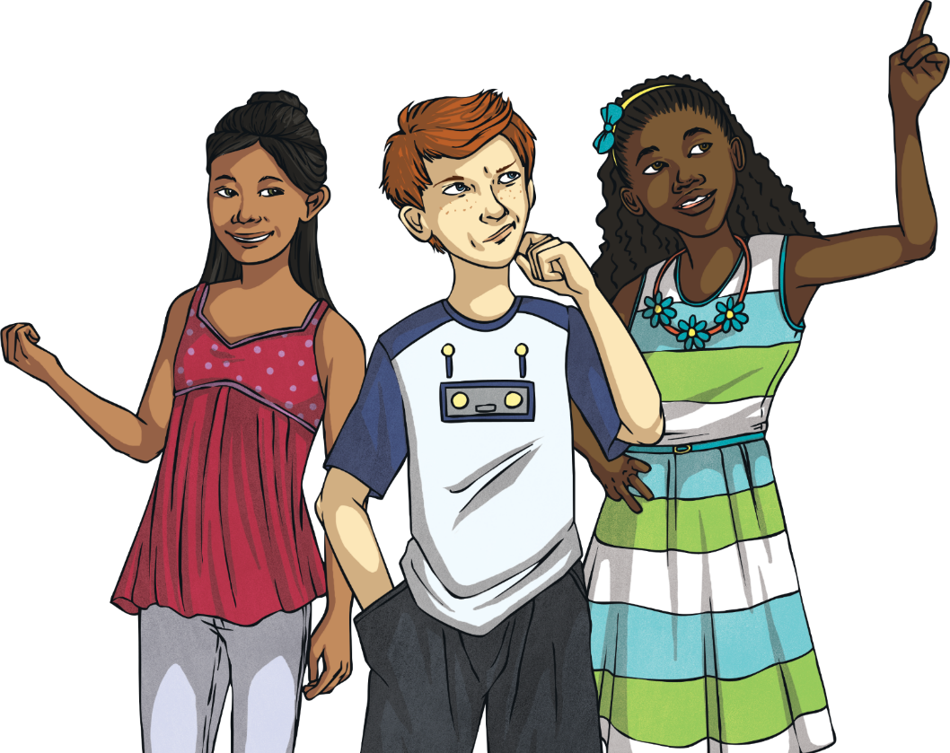
Fashion
What are your favourite things to wear? Why do you like wearing them? Have your tastes in fashion changed over time? If so, how?
If you think fashion has changed during your lifetime, wait until you learn about how much it has changed in history.
Let’s take a trip back in time to learn about clothing from the past.

Slide 3
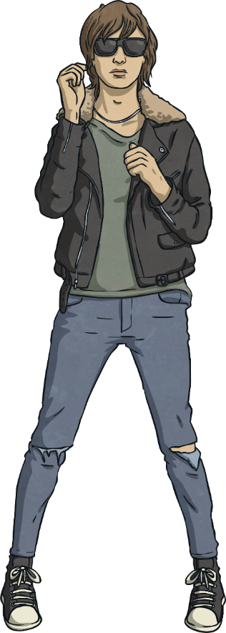
1990s/2000s
Fashion
Cargo trousers with pockets down the side were popular in the 1990s.
The mid 1990s were known as ‘Cool Britannia’. Pop groups made parka jackets and longer hair popular. During the 2000s, jeans got skinnier.
Denim was popular with both men and women.
In the late 1990s, jeans were wide at the bottom and very long; jeans often dragged along the floor and got very wet on rainy days.
Very low-rise jeans and cropped tops were in fashion in the early 2000s.

Slide 4
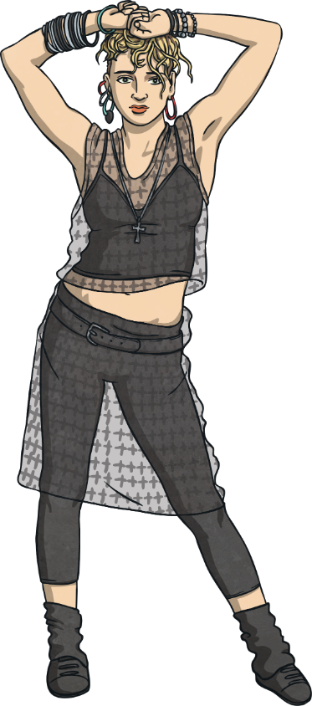
1980s
Fashion
White slip-on shoes were popular with men in the 1980s.
Clothing was bright and often had patterns. Jeans were stone-washed which made them an icy-blue with markings on them. Ripped jeans became popular in the 1980s.
Leggings worn under short floaty skirts were a popular choice for women.
Leg warmers worn around the ankles were in fashion.
Jackets with big shoulder pads and rolled up sleeves were fashionable for both men and women.

Slide 5
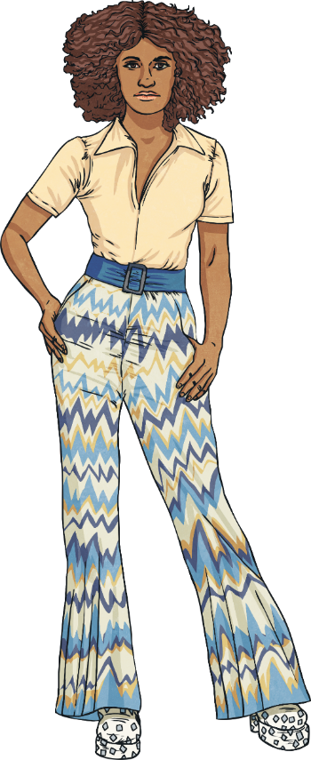
1970s
Fashion
Trousers that started off tight but flared from the knee down (known as flares or bell bottoms) were popular.
Tie dying clothes was fashionable. This was when string was tied around clothes which were then dipped in dye, creating swirling patterns.
Other clothing was floaty and bright. The mini-skirts of the 60s were replaced by ankle-length ones known as maxi-skirts.
Platform shoes, with large soles and heels were fashionable.
Floppy hats with wide brims were popular for women to wear.

Slide 6
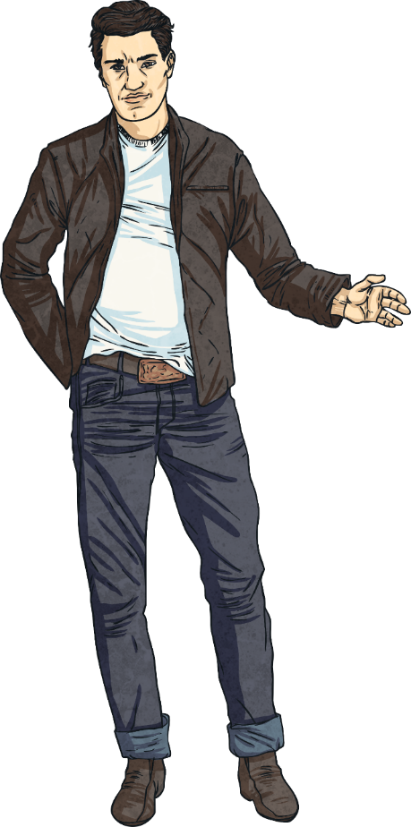
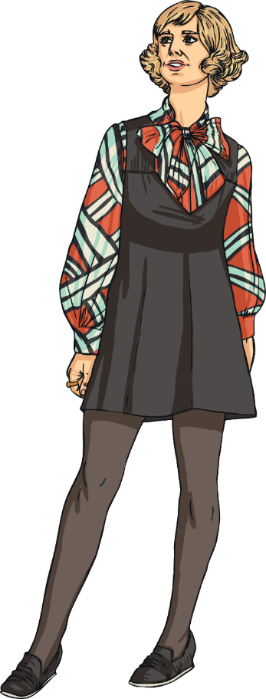
1960s
Fashion
The big fashion craze of the 60s for women was the mini-skirt. Many people from older generations were scandalised by the length of these skirts and dresses!
Towards the end of the decade, hot pants (very short shorts) were coming in to fashion.
Tights had started being sold in the 1950s and were becoming more popular. Over-sized bows and collars on dresses and blouses were popular.
Inspired by groups such as The Beatles, men’s fashion was still often fairly formal, with suits and ties being popular.
There were groups known as ‘Rockers’ who wore jeans, t-shirts and denim jackets.

Slide 7
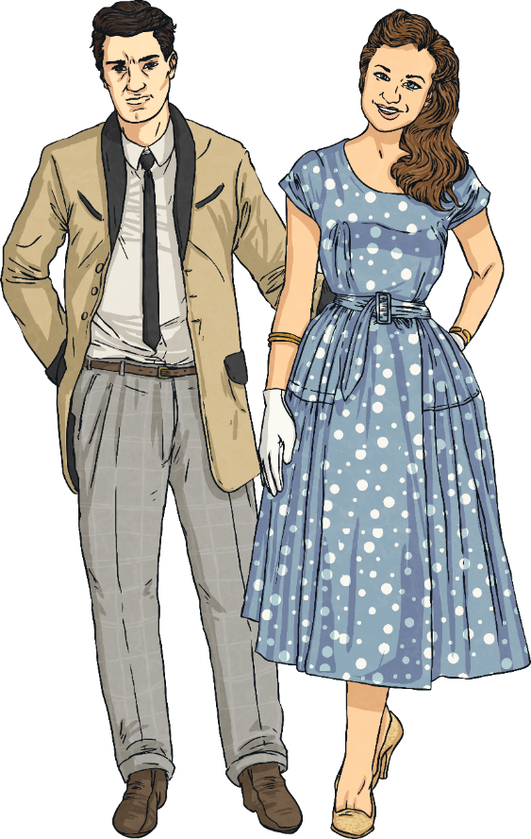
1950s
Fashion
The fashion of the 1950s was still quite formal.
Dresses and skirts came to below the knee, and were made to stand out by putting lots of petticoats underneath.
Women frequently wore hats or head scarves and gloves. Although women didn’t wear trousers as often as today, slim-fitting knee-length trousers called capri pants started being worn.
Men often wore suits. On more casual days, they might wear a pull over instead of a suit jacket, but still usually wore a tie.
Hats such as homburg hats were still popular. Younger men started to wear jeans, which had traditionally been work wear for men who worked in factories.

Slide 8
1920s
Fashion
Women’s dresses became shorter and less restrictive in the 1920s.
Dresses were below the knee and had a drop waist (where the waist line of the dress fell below the natural waist line).
Women who followed fashions like the one in this picture were known as ‘flapper girls’. The hat in the picture is called a cloche hat and was very popular in the 20s.
Suits, ties and hats were popular with men. Pin striped suits were fashionable in the 20s.
Hats including ones called fedoras and homburgs were also in fashion. Some men wore white coverings called spats over their shoes.

Slide 9
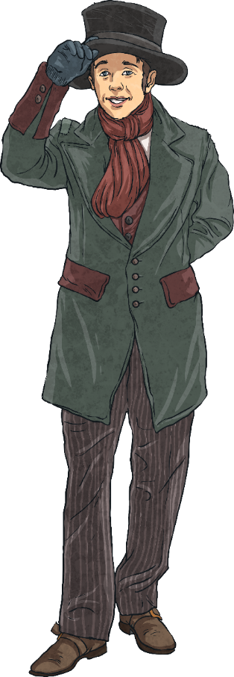
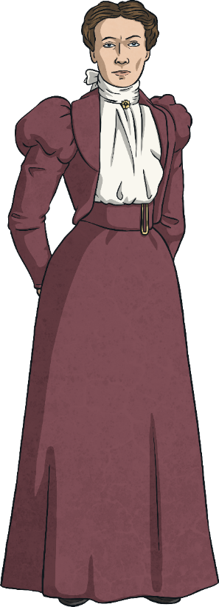
The Victorian Era (1837 – 1901)
Fashion
Wealthy Victorian men wore suits with waistcoats. Bowler hats and top hats were popular. A pocket watch was often carried.
Rich women wore corsets pulled very tight. Hoops and petticoats were worn to make skirts stand out. At one point, bustles were popular. These gave extra shape to the back of a skirt.
Poor people’s outfits had to be practical and hard-wearing. Clothes were dark as it was difficult to keep clothes clean in factories and mines where many poor people worked.
Poor people had to make their shoes last. Many wore hobnail boots which had nails hammered in to the soles to make them last longer.
Men and women wore hats or caps. Men took their hats off inside, women often kept theirs on.

Slide 10
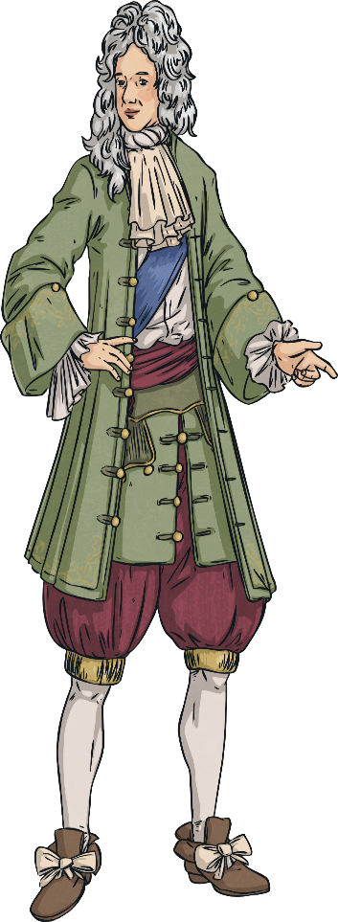
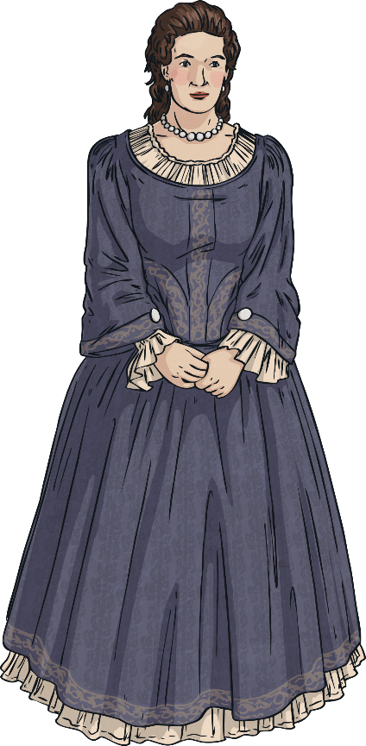
The Stuart Era (1603 – 1714)
Fashion
Clothing for the rich during the Stuart era was very elaborate.
Lace was a popular material for both men and women, and sleeves were often edged with it.
Many clothes were made from silk brocade, a very expensive fabric.
Men wore breeches, a type of trouser that went to just above the knee. Silk stockings were worn by men and women.
Men and women both wore curled wigs. Both men and women wore make up.

Slide 11
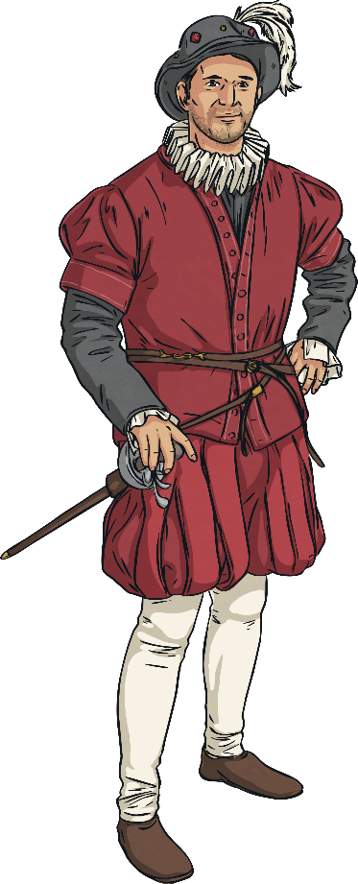
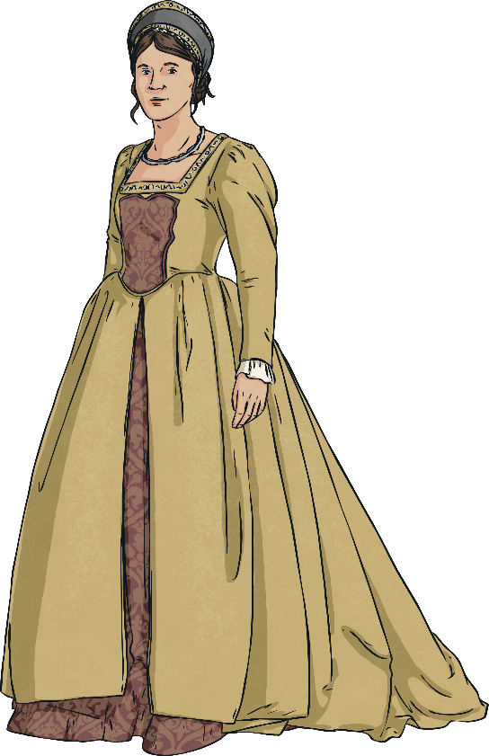
The Tudor Era (1485 – 1603)
Fashion
Tudor men wore outfits called a doublet and hose.
A doublet was a tight fitting jacket worn over the hose which were short-length trousers worn above the knee, a bit like modern day shorts.
They wore white silk stockings and hats decorated with feathers and jewels.
Ruffs (circular collars made of lace and silk) were worn by men and women. The more fashionable a person was, the bigger the ruff would be.
Skirts were worn over frames to give the shape shown in the picture. Clothing was made of linen, silk and wool.

Slide 12
Fashion
What similarities and differences did you notice? What fashion did you like the most and why? What fashion did you like the least and why?

